Slide 1
Unit 1 Quantities & Units
Part B: Scientific Notation

Slide 2
What will you learn?
Represent very large and very small numbers in scientific notation.
Perform arithmetic operations on numbers in scientific notation.

Slide 3

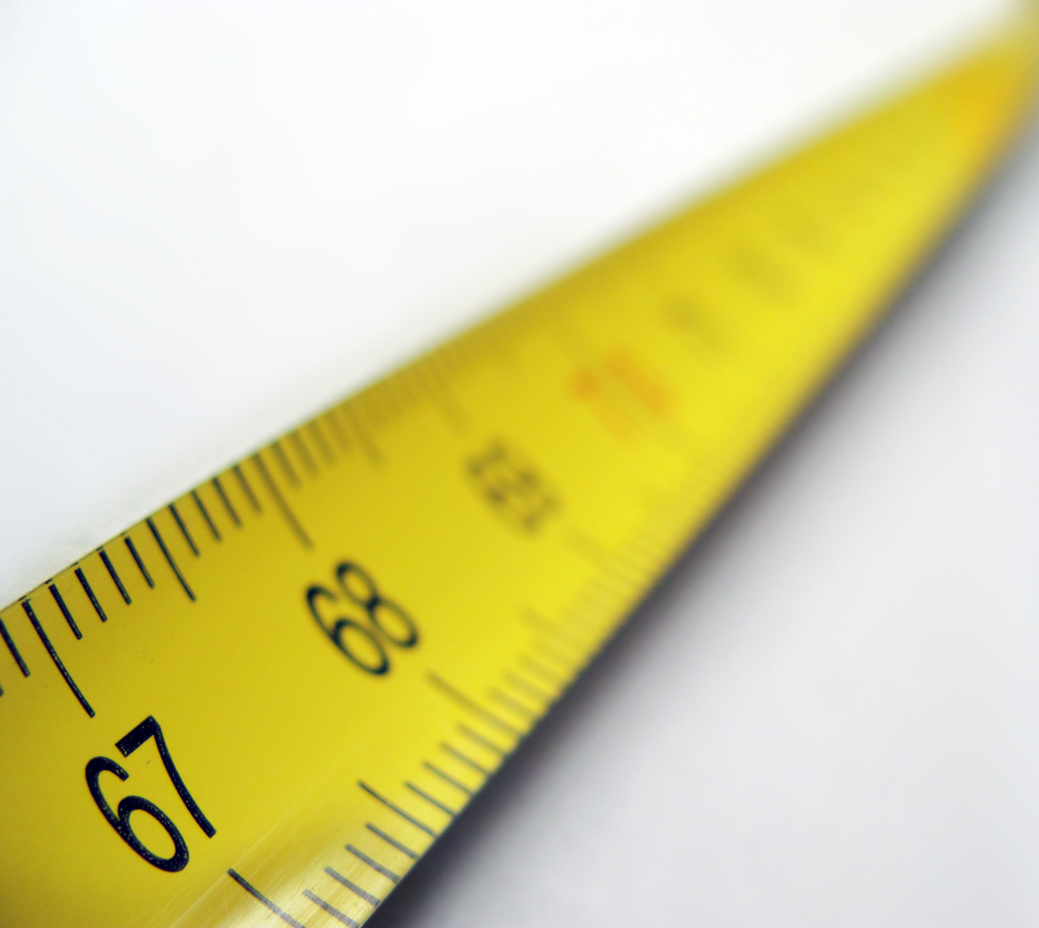

Example of an extremely large number:
Have you ever wondered how far is the sun from us?
149,597,870,700 m
Or after rounded up
150,000,000,000 m
Or using km
150,000,000 km

Slide 4
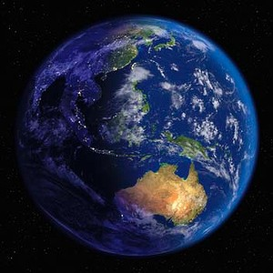
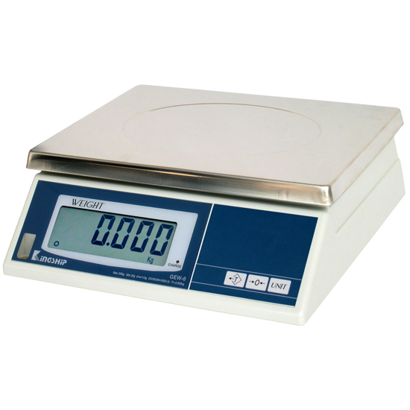
Another extremely large number:
What is the mass of the earth?
6,000,000,000,000,000,000,000,000 kg

Slide 5


Example of an extremely small number:
Estimate the thickness of your hair.
Let’s say, 0.0000254 m

Slide 6
Writing a number in scientific notation:
Number n = a × 10^{b}
where ‘a’ is the coefficient and is a real number,
the exponent ‘b’ is an integer.
1 ≤ |a|< 10
i.e. −10 < a ≤ −1 or 1 ≤ a < 10
−10
−1
1
10

Slide 7
Express the distance, 346.2 km, between KL and Singapore in scientific notation.
1 ≤ |a|< 10
346.2 km
=
3.462
×10²
km
Only one digit integer before the decimal point.
±1, ±2, …, or ±9 but not 0.

Slide 8
The speed of light in vacuum is approximately equal to 300,000 km/s. Express it in scientific notation.
300,000 km/s
=
3.00000
×10⁵
=
×10⁵
km/s
5 4 3 2 1
3

Slide 9
The diameter of a strand of hair is measured to be 0.0000254 m. Express it in scientific notation.
0.0000254 m
×10⁻⁵ m
=
2.54
1 2 3 4 5

Slide 10
Add 2.56 × 10⁶ to 8.18 × 10⁵ and express the result in scientific notation.
Two numbers to be added must have the same exponent.
You can convert either number so that both have the same exponent.
8.18 × 10⁵ = 0.818 × 10⁶
Add the coefficients of the two numbers of same exponent.
(2.56 + 0.818) × 10⁶ = 3.378 × 10⁶
×10
÷10

Slide 11
Subtract 9.84 × 10⁻⁸ from 4.12 × 10⁻⁷ and express the result in scientific notation.
Two numbers to be added must have the same exponent.
(4.12 × 10⁻⁷) − (9.84 × 10⁻⁸)
= (4.12 × 10⁻⁷) − (0.984 × 10⁻⁷)
= (4.12 − 0.984) × 10⁻⁷
= 3.136 × 10⁻⁷
(4.12 × 10⁻⁷) − (9.84 × 10⁻⁸)
= (41.2 × 10⁻⁸) − (9.84 × 10⁻⁸)
= (41.2 − 9.84) × 10⁻⁸
= 31.36 × 10⁻⁸
= 3.136 × 10⁻⁷

Slide 12
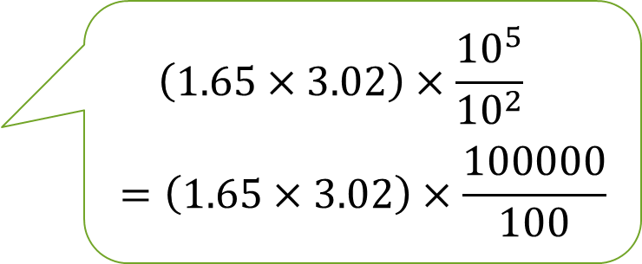
Multiply 1.65 × 10⁻² and 3.02 × 10⁵ and express the result in scientific notation.
Two numbers performing multiplication do not require same exponent.
(1.65 × 10⁻²) × (3.02 × 10⁵)
= (1.65 × 3.02) × (10⁻² × 10⁵)
= (1.65 × 3.02) × 10⁻²⁺⁵
= 4.983 × 10³
$$\left(1.65×3.02\right)×\frac{{10}^{5}}{{10}^{2}}$$
$$=\left(1.65×3.02\right)×\frac{100000}{100}$$

Slide 13
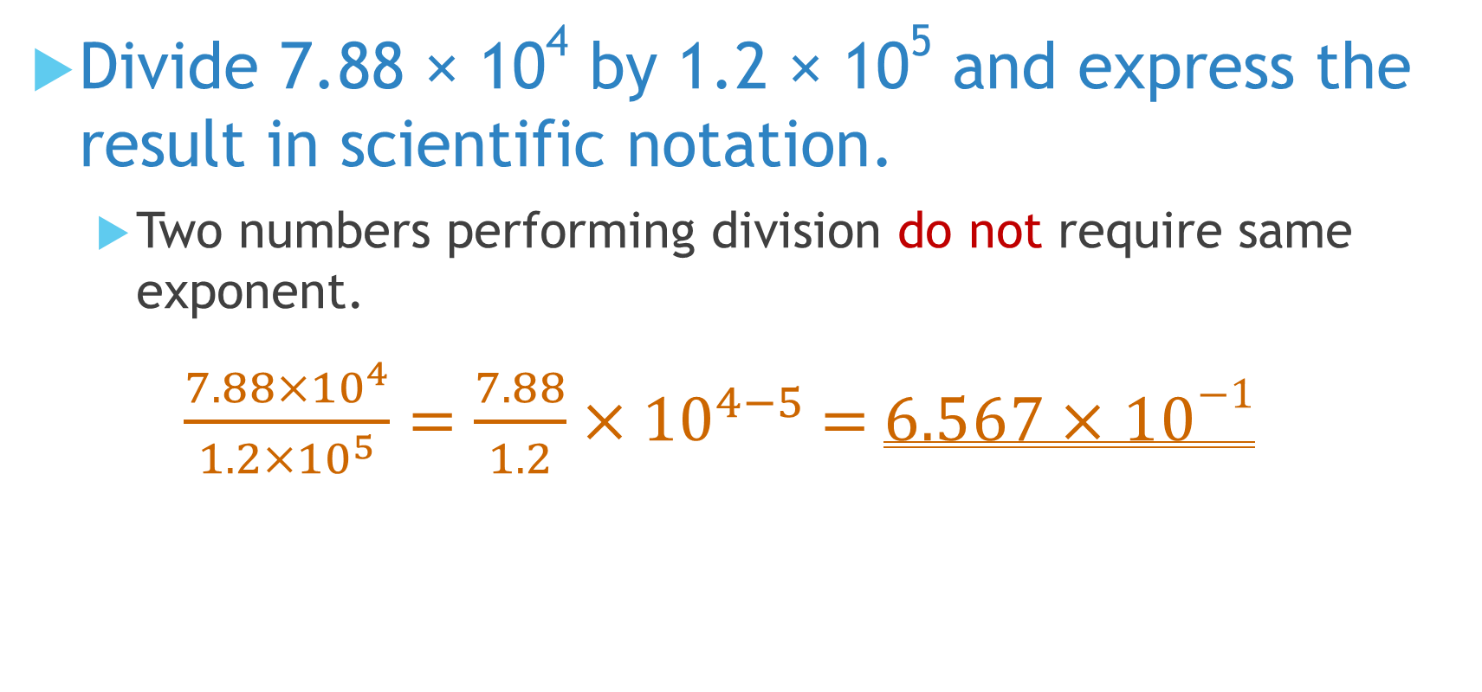
Divide 7.88 × 10⁴ by 1.2 × 10⁵ and express the result in scientific notation.
Two numbers performing division do not require same exponent.
$\frac{7.88×{10}^{4}}{1.2×{10}^{5}}=\frac{7.88}{1.2}×{10}^{4−5}$ = 6.567 × 10⁻¹

Slide 14
What you have learned?
Represent very large and very small numbers in scientific notation.
Perform arithmetic operations on numbers in scientific notation.

Slide 15
Coming Up Next
Engineering Notation

